Slide 1
Public Support Study on Banning Smoking in Taxies
2020
Ana Dekanosidze
Non-communicable Diseases Department
National Center for Disease Control and Public Health
December, 2020

Slide 2
Methods
Type of the Research
Quantitative
Study Instrument
Structured Questioner
Study Population
Population of Georgia (18+)
Research Method
Phone interview
Selection
Multivariate Stratified Random Sampling
Type of Settlement | Number of Interviews | Standard Deviation (95% Confidence Interval)
City | 373 | 5.1%
Village | 304 | 5.5%
Capital city | 324 | 5.4%
Notes:
ა) 11 რეგიონში (თბილისის ჩათვლით) რესპონდენტები გადანაწილებულია მოსახლეობის ზომის პროპორციულად;
ბ) მოსახლეობის ზომის პროპორცია დაცულია, ასევე, რეგიონებში შემავალ სტრატებში

Slide 3
Are you smoking or have you ever smoked any type of tobacco?
Yes
No
I quit
No response
Yes
No
I quit
Male
Female

Slide 4
Do you think secondhand smoke is harmful?
Female
Yes

Slide 5
Have you ever smoked in a taxi? (among smokers)

Slide 6
Have you asked the driver for permission?

Slide 7
Has anyone smoked in a taxi in your presence?
Has tobacco smoke bothered you in a taxi?

Slide 8
Do you support smoking ban in taxies?

Slide 9
Do you support smoking ban in private vehicles when minors are present?

Slide 10
Are you satisfied with total ban of smoking in public transport?

Slide 11
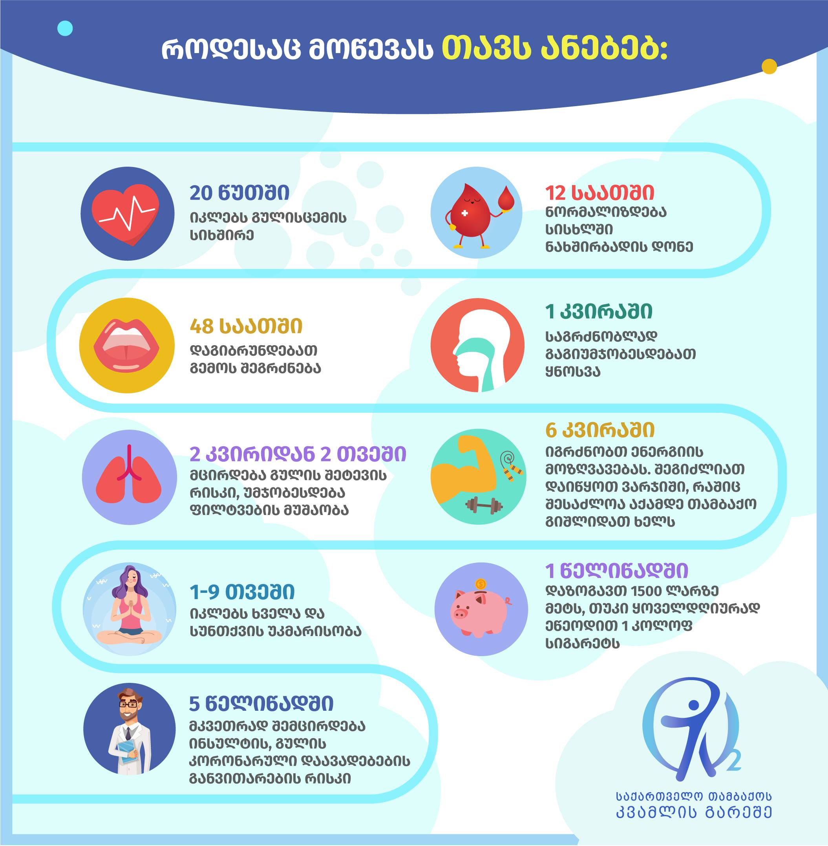
Thank you very much for your attention!
a.dekanosidze@ncdc.ge

