Slide 1
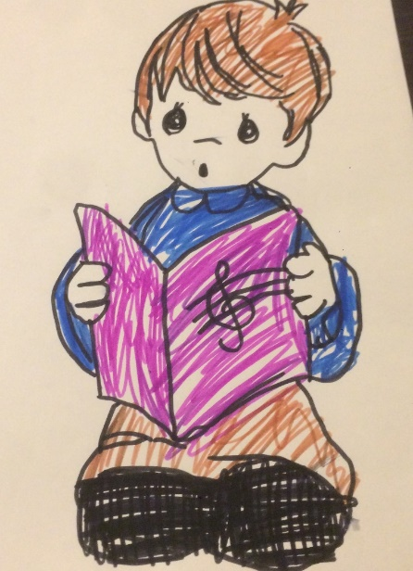
Childhood Obesity Surveillance Initiative (COSI) Georgia 2017
NCDC

Slide 2
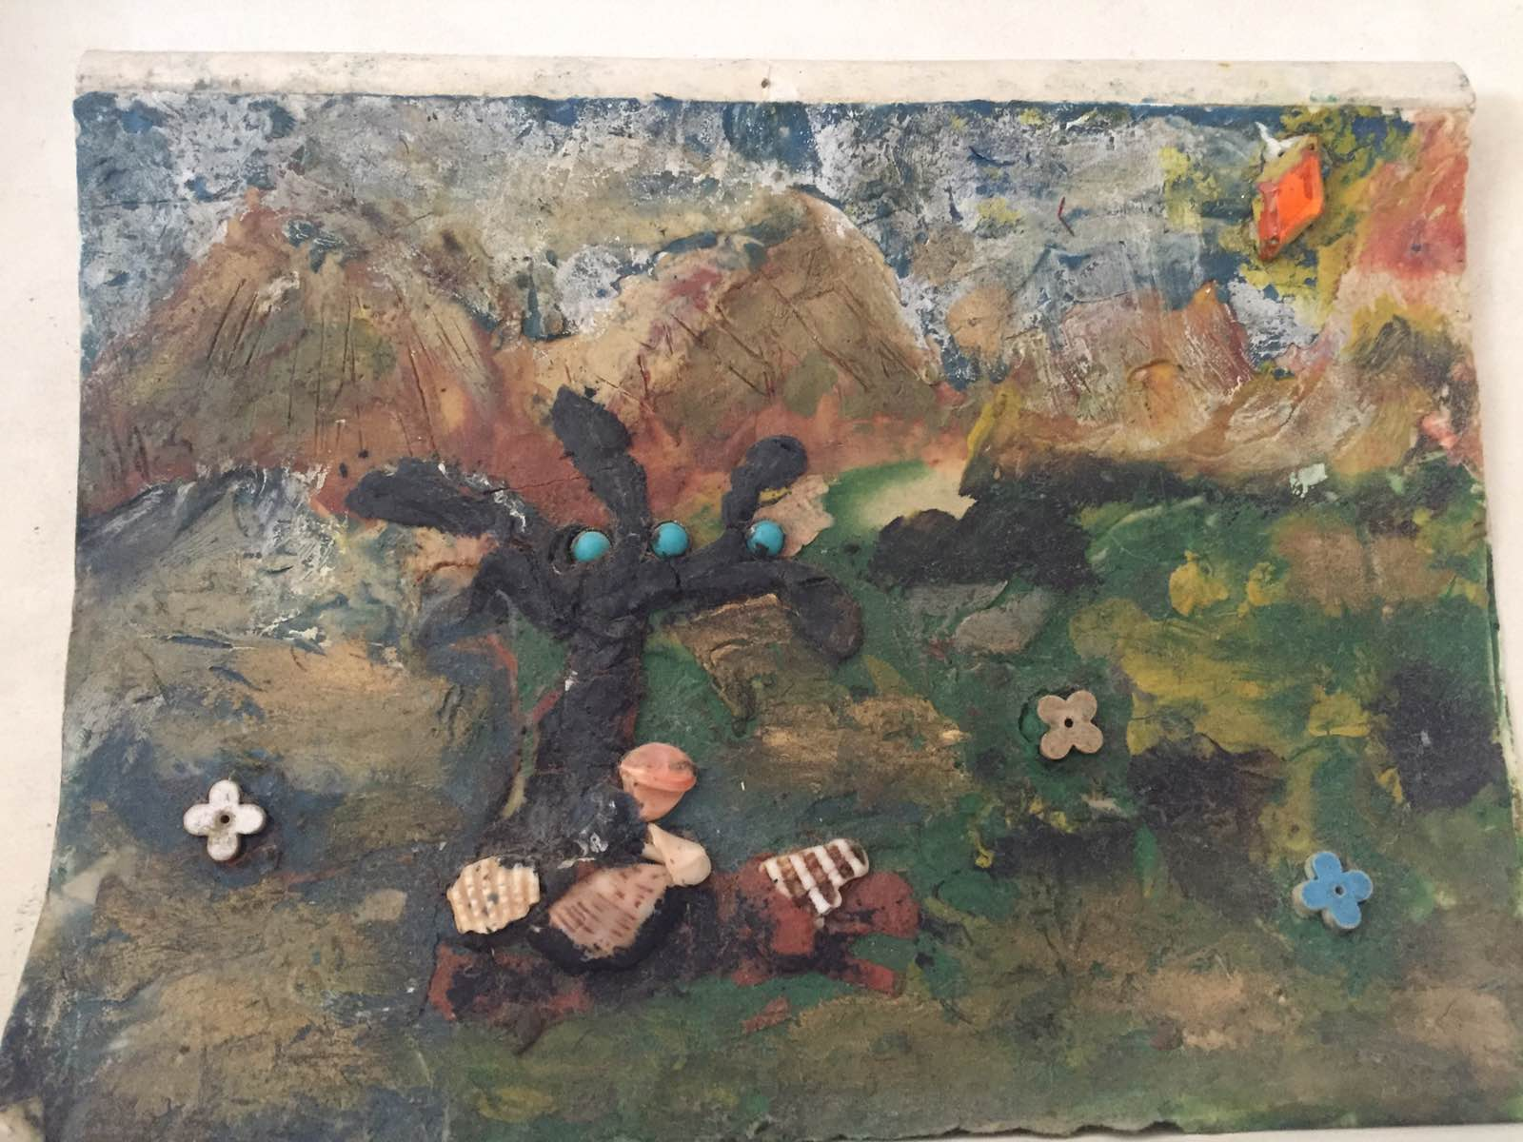
Table of Contents
page
page
page
page
page
3
14
19
25
39
Introduction
Results
Children's Eating Habits
Physical activity
School environment
page
page
39
40
Summary
Recommendations

Slide 3
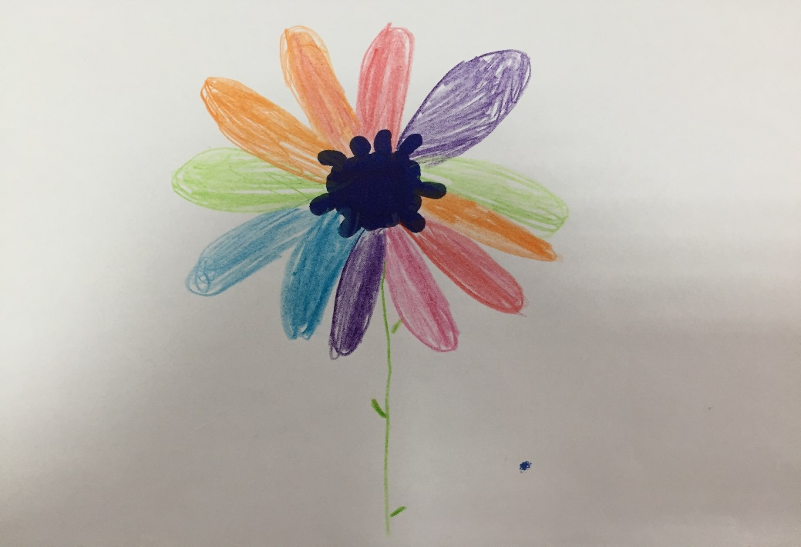
Introduction
Introduction
Methods
Sampling
Study participants
Study characteristics
World Health organization cut-off points for underweight, overweight and obesity

Slide 4
Introduction
Childhood obesity is a major public health problem globally, with the potential to undermine progress towards achieving the SDGs. Prevention is recognized as the only feasible option for curbing the epidemic. Unhealthy diet, malnutrition and sedentary lifestyles are important causes of childhood obesity.
Childhood obesity is a multifactorial disease associated with a wide range of serious health and social consequences including a higher risk of premature death and disability in adulthood.
Severe obesity in children is associated with immediate and long-term cardiovascular, metabolic and other negative health outcomes. When comparing overweight children to children with severe obesity, the latter have a much worse cardio-metabolic risk factor profile.
This study is the first that investigates the prevalence of severe obesity in school children in Georgia.

Slide 5
Methods:
The following procedure was done to select a study sample of children:
The study population:
3375, 7 years old pupils participated in the study
Primary public and private school classes were randomly selected from the list of schools provided by Ministry of Education and Science.
All children belonging to sampled classes are included in the study. This is a one-stage cluster sampling design with primary school classes as clusters.

Slide 6
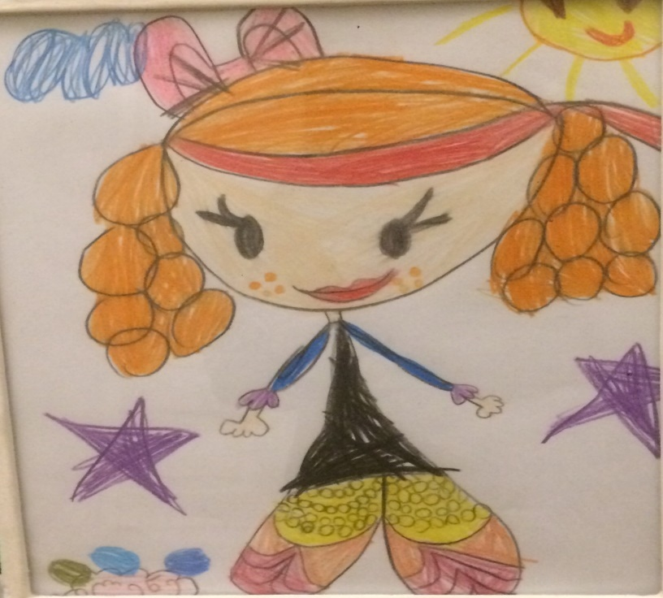
Methods
Anthropometric measurements such as height, weight, and waist and hip circumferences, were recorded.
The pupils were also asked about their physical activity and dietary habits.
The school environment data included the number of physical education lessons per week and the opportunities for attending sports activities, as well as information about the foods and beverages available to the pupils, and health promoting activities and projects organized in the school.
The Georgian COSI questionnaire follows the international COSI survey protocol.
The research protocol is developed according to the international standard questionnaire.

Slide 7
Methods
Weight was measured in kilograms, to the nearest 100 gram unit (0.1 kg). The stadiometers were mounted at a right angle between a level floor and against a straight vertical surface (wall or pillar). Children’s height was measured in centimeters and the reading taken to the last completed 1 millimeter (mm). Waist circumference was measured in cm and recorded to the nearest mm.
During measurement children were asked to wear normal, light, indoor clothing without shoes. Hair ornaments were removed and ponytails undone and all children were asked to empty their pockets.

Slide 8
Sampling
Nationally representative study was done in 2017
 | Boys | Girls | Total
Number of children enrolled in selected schools | 2019 | 2124 | 4143
Number of measured children | 1723 | 1620 | 3343
Number of children belonging to target age groups (7-year-olds) | 1451 | 1376 | 2827
Families participation rate | 83% | 74% | 78%

Slide 9
Nationally representative study was done in Autumn 2017
Family Survey form was a part of the study. Through this survey, information regarding the child’s diet and physical activity pattern and family’s socioeconomic characteristics and co-morbidities was obtained.
Data were recorded into an electronic data entry system, OpenClinica.
Data were checked for inconsistencies. The final dataset only included children with informed consent and complete information on age and sex.
BMI is considered to be the best available population marker for monitoring trends in obesity. It
is calculated from the formula, weight in kg/height in M²

Slide 10
World Health organization cut-off points for underweight, overweight and obesity according to body mass index (BMI) for Boys
The percentile cut-off points for boys at age 5:1-7:6 years corresponding to BMI cut-off points for underweight, normal weight, overweight and obesity are used to calculate percentiles and z-scores for children at different ages and sex.

Slide 11
World Health organization cut-off points for underweight, overweight and obesity according to body mass index (BMI) for Boys
The percentile cut-off points for boys at age 7:7-10:0 years corresponding to BMI cut-off points for underweight, normal weight, overweight and obesity are used to calculate percentiles and z-scores for children at different ages and sex.

Slide 12
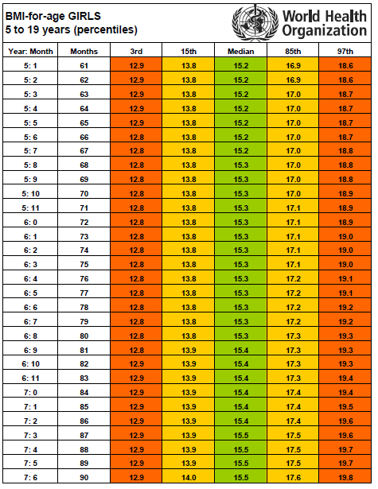
World Health organization cut-off points for underweight, overweight and obesity according to body mass index (BMI) for Girl
The percentile cut-off points for girls at age 5:1-7:6 years corresponding to BMI cut-off points for underweight, normal weight, overweight and obesity are used to calculate percentiles and z-scores for children at different ages and sex.

Slide 13
World Health organization cut-off points for underweight, overweight and obesity according to body mass index (BMI) for Girl
The percentile cut-off points for girls at age 7:7-10:0 years corresponding to BMI cut-off points for underweight, normal weight, overweight and obesity are used to calculate percentiles and z-scores for children at different ages and sex.

Slide 14
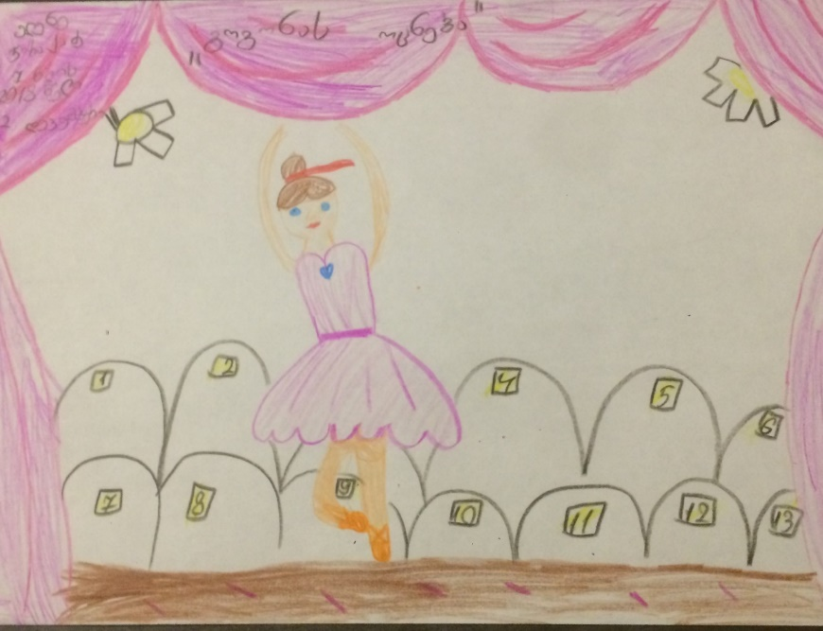
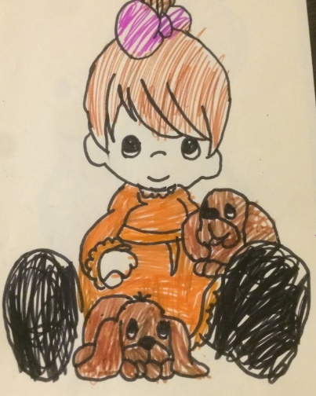
Results
Overweight among children aged 7 years
Obesity among children aged 7 years
Underweight among children aged 7 years
Stunting among children aged 7 years

Slide 15
Prevalence of Overweight Based on WHO Growth Curves among children aged 7 years

Slide 16
Prevalence of Obesity Based on WHO Growth Curves among children aged 7 years

Slide 17
Prevalence of Underweight Based on WHO Growth Curves among children aged 7 years

Slide 18
Prevalence of Stunting Based on WHO Growth Curves among children aged 7 years

Slide 19
Children's Eating Habits
Breakfast
Fruits
Vegetables
Savoury Snacks
Soft Drinks

Slide 20
In addition to the physical measurements that are used to calculate levels of overweight and obesity, information on the obesity-related behaviours of study participants is collected through a questionnaire for the parents of study participants.
Eating habits are an important factor in children becoming overweight and obese. COSI collects some information on health-related behaviours to provide the information necessary for policy-makers to design, implement and evaluate the effectiveness of policies and strategies aimed at improving diets. reduce the risk of becoming overweight or obese.
Greater availability and affordability of energy-dense, nutrient-poor foods and drinks has contributed to an environment that encourages weight gain and in which many children now grow up. Regularly eating breakfast, daily consumption of fruits and vegetables and limited consumption of foods such as savoury snacks, fast foods, processed meat products and sugary soft drinks

Slide 21
Majority of children have breakfast every morning

Slide 22
On the question: Over a typical or usual week, how often does your child have breakfast? Parents answer was following:

Slide 23
Children's Eating Habits
Over a typical or usual week, how often does your child consume the following kinds of foods or beverages?

Slide 24
Children's Eating Habits
Over a typical or usual week, how often does your child consume the following kinds of foods or beverages?

Slide 25
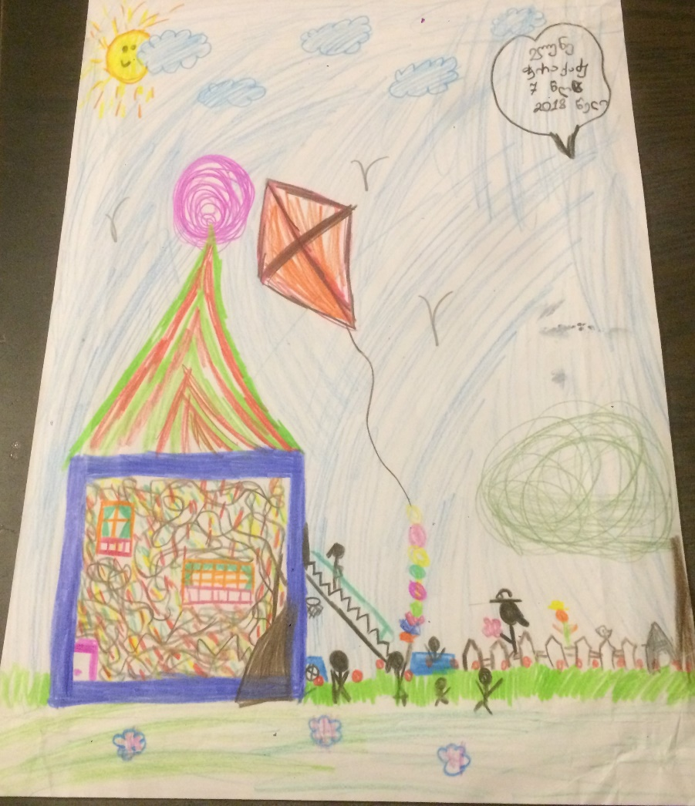
Physical activity
Physical activity among 7 years old Children
Moderate physical activity
Vigorous physical activity
Family information

Slide 26
Physical activity among 7 years old Children
WHO recommends that children carry out at least 60 minutes of moderate-to-vigorous physical activity a day, but only a small proportion of children currently meet this recommendation. Active transportation, such as walking or cycling, is associated with higher levels of physical activity and cardiovascular fitness but in many countries the proportion of children walking or cycling to or from school has been declining.
Physical activity patterns are closely linked to the energy imbalances that result in children becoming overweight and obese. The benefits of physical activity, which includes active play, walking, cycling and participation in sports, are important for children’s physical and mental health and habitual physical activity is associated with lower levels of overweight in children.

Slide 27
Mort of the children lives 1 or 2 kilometers away from schools and walking to school every day

Slide 28
The study gathered data on different extracurricular sports or physical activities organised for the primary school classes (by the school itself or by sports clubs and non-profits), and whether these activities and classes were provided for free and for fee.

Slide 29
Family information

Slide 31
School environment
Factors related to the school environment
Physical activities and physical education Physical activities and physical education
Getting to and from school
What can be done?

Slide 32
245 schools participated in the study
All participating schools were asked to fill out a form about the school environment.
The form was filled out by the school principal or head teacher. The aim of the form was to learn if there was an outdoor playground or indoor gym available at the school, how many minutes of physical education lessons the school provided to the pupils of each first grade in a week, and whether the school organized any sports activities outside school hours.
The school representative was also asked to assess the safety of the pupils’ route to and from school, choose from a list the foods and beverages available at their school, and answer questions about health promoting activities and projects organized in the school.

Slide 33
Factors related to the school environment
The school record form included questions about the availability of an outdoor playground and indoor gym. If there was no gym on the school premises, the representative was asked whether the pupils could use another nearby gym. The examiner also asked whether the pupils were allowed to use the playground and gym outside school hours.

Slide 34
Physical activities and physical education
Approximately of fifth all schools did not have a playground on school premises. The percentage of schools who had a gym was 76.4%. Share of schools who had regular physical activities or physical education lessons for all grades were 60.7%. 13.2% of schools reported to have regular physical activities or physical education lessons for some classes. More than 23% of schools reported not having regular neither physical activities nor physical education lessons.
Therefore, quite big amount of all pupils did not have opportunity to use gym.

Slide 35
Getting to and from school
Almost a half of all pupils used a motorised vehicle to get to school, while the number of pupils who used motorised vehicles for leaving school was a fifth smaller.
little over a third (36%) walked or cycled to school and 45% used this means of transportation for going home. More than 39% of the pupils used a combined method of transportation (both walking/cycling and motorised vehicles) for getting to and from school.
About half of the pupils (48.3%) always walked or cycled, only 12.3% always used a motorized vehicle.

Slide 36
Getting to and from school
Availability of school buses
In some cases schools also provide buses as well, mostly in remount areas. The buses getting to and from school children every day.

Slide 37
What can be done?
The appropriate and context-specific nutrition information and guidelines for both adults and children should be developed and disseminated in a simple, understandable and accessible manner to all groups in society.
Inform the population about childhood overweight and obesity and consequences for health and well-being.
Impelemnt guidance on the prevention of childhood obesity through the consumption of a healthy diet throughout the life course.
Develop and implement evidence-based, public education campaigns about a healthy diet and the need for it and for physical activity.
Implement the set of recommendations on the marketing of foods and non-alcoholic beverages to children to reduce the exposure of children and adolescents to, and the power of, the marketing of unhealthy foods.
Assess the impact of legislation, regulation and guidelines to tackle the marketing of unhealthy foods and non-alcoholic beverages to children, where required.
• Adopt, and implement effective measures, such as legislation or regulation, to restrict the marketing of foods and non-alcoholic beverages to children and thereby reduce the exposure of children and adolescents to such marketing.
• Establish mechanisms to effectively enforce implementation of legislation or regulation on the marketing of foods and non-alcoholic beverages to children.

Slide 38
What can be done?
Conduct regular high-level policy dialogues on childhood obesity.
Mobilize sustainable resources to tackle childhood obesity.
Provide guidance to children and adolescents, their parents, carers, teachers and health professionals on healthy body size, physical activity, sleep behaviours and appropriate use of screen-based entertainment
Ensure that adequate facilities are available on school premises and in public spaces for physical activity during recreational time for all children (including those with disabilities), with the provision of gender-friendly spaces where appropriate

Slide 39
Summary
3375, 7 years old pupils participated in the study in 2017
Anthropometric measurements such as height, weight, and waist and hip circumferences, were recorded
Prevalence of Overweight Based on WHO Growth Curves among children aged 7 years 22.1 among girls and 26.1 among boys
Prevalence of Obesity Based on WHO Growth Curves among children aged 7 years 10.3% among boys and 7.2% among girls

Slide 40
Conclusions
According to the present study, every fifth second-grade pupil was overweight or obese. Considering the possible health risks, the percentage of overweight and obese children is significant and a definite cause for concern
1
2
The primary causes for excess body weight are inadequate exercise and an unbalanced diet.
From a public health perspective, childhood obesity has proven to be a serious problem in Georgia much like in other European countries.
Obesity creases the risk of developing overweight and other health issues (type II diabetes and cardio-vascular diseases) in adulthood.
Based on the current data analysis, reaching or maintaining a healthy BMI can be facilitated by engaging the child in extracurricular sports and ensuring that the child starts their day with a balanced breakfast
3
it is good that some of the schools had physical education lessons in their curriculum, however, not all schools in the country have physical activity lessens. Moreover, Some of them don’t have separate place to organize such activies.
4
It is also positive that a majority of the second-grade pupils had the opportunity to use a gym and a playground. However, none schools can provide receive free unsweetened dairy products, vegetables and fruits at school.
5
Moreover, many schools provide their pupils with sweets and sugary soft drinks and juice drinks which does not promote a healthy diet
6

